Slide 1
Graph database

Slide 2
Table of contents
Graphs and network modelling
Advantages of graph databases

Slide 3
1. What is a graph
Graph is mathematical objects consist of 2 parts: vertices and edges
Vertices represent things
Cities
Employees in the company
Proteins
Electrical circuits
Junctions in water line
Organisms in an ecosystem
Train stations
…

Slide 4
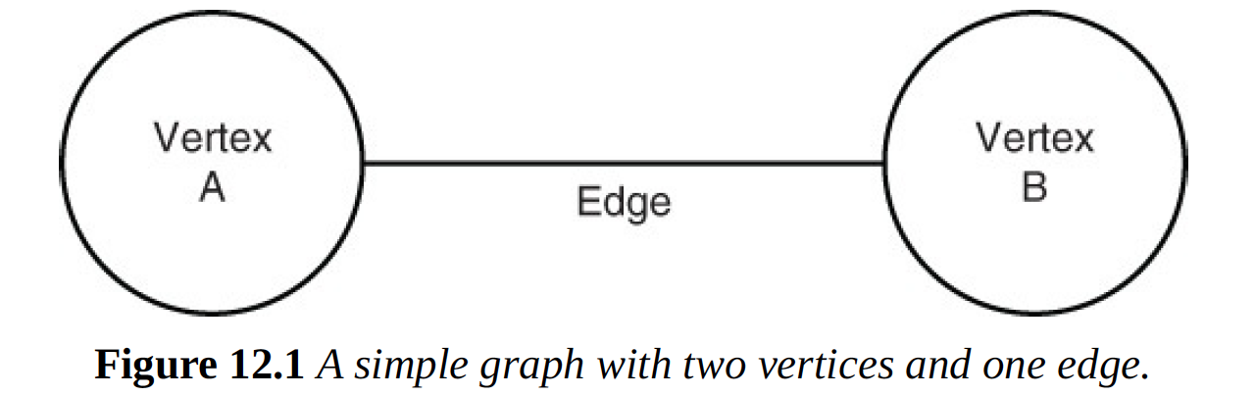
Contd
They have relationship to other things – often in the same category
For example: Cities connect to other cities by roads
Employees work with another employees
Proteins interact with other proteins
…
Link between entities is called edge

Slide 5
2. ﻿Graphs and Network Modeling - Modeling geographic locations
Geographic locations are modeled as vertices. These could be cities, town or intersections of high-ways
Vertices have properties like name, latitudes, longitudes.
In the case of town and city: population & size/m2 are 2 properties.
Highway and railway are modeled as edges between 2 vertices.
They also have properties: length, year built, and maximum speed.

Slide 6
Railway and highway (contd)
﻿Highways could be modeled in two ways. ﻿
A highway could be a single edge between two cities, in which case it models the road traffic in both directions. ﻿
Alternatively, a graphical representation could use two edges, one to represent travel in each direction (for example: east to west and west to east). Which is the “right way” to model highways?
If goal is to model distance and approximate between cities, then single edge is sufficient.
If detail information includes direction, number of lanes, current construction area, location of accidents, then using 2 edges is a better option.

Slide 7
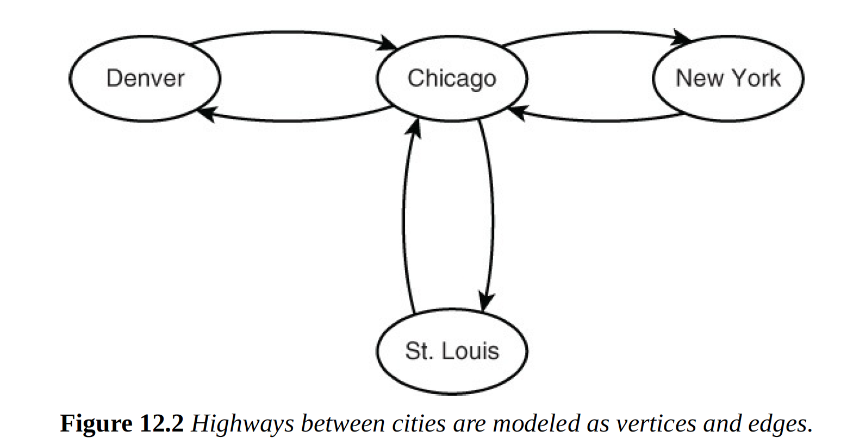
Direction traffic is flowing – directed edge
Direction traffic is flowing – directed edge

Slide 8
Graphs and Network Modeling - Modeling Infectious Diseases
﻿Infectious diseases can spread from person to person.
For example, a person coughs into his hand and bacteria and viruses are left on his hand. When that person shakes the hand of someone else, there is a chance that a pathogen is transmitted to the other person, who may eventually become infected
The spread of infectious disease is readily modeled using graphs
Both the vertices and edges have properties that help represent the way diseases spread.

Slide 9
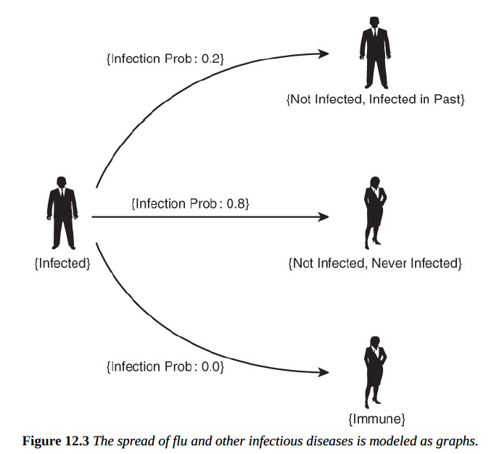
Edges (Have properties)
- Probability
Vertices
(have properties)
Vertices (have properties)
Age
Weight
Infection status:
Not infected now, never infected be4
Not infected now, infected be4
Infected now
Immune

Slide 10
Why to keep tracks of properties above
➔ To calculate probability of becoming infected.
If you are not infected now and never have been, you have a moderately high probability of becoming infected.
If you are not infected now, but infected in the past; therefore, immunity has developed, probability of getting infected is low.
If infected now and come in contact with another infected person, both continue to be infected. No change
If you are immune, then you will not become infected.
➔ This state of graph continues to change if person contacts with another person.

Slide 11
Modeling abstract and concrete entities
Graphs are well suited to model abstract relations, like part-of relation. For example: USA has Oregon state, city of Portland located in Oregon. Canada has Quebec state, v.v. ➔ tree graph
All nodes connect up to only one other vertex. Upper vertex is often called parent vertex, and lower vertices are called children vertices.
Parent vertices can have multiple children vertices.

Slide 12
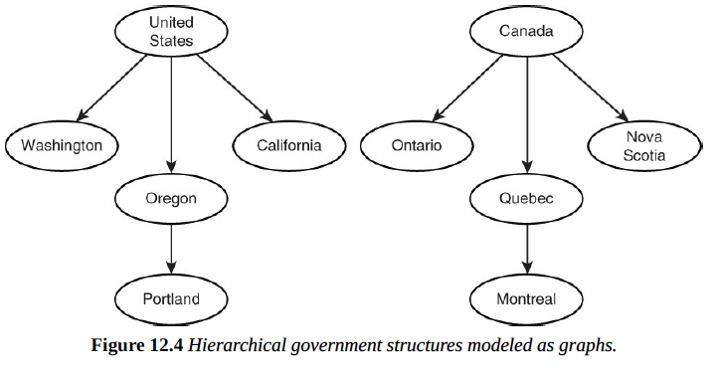
National – root.
Regional– parent vertex
Government cities – child vertex.

Slide 13
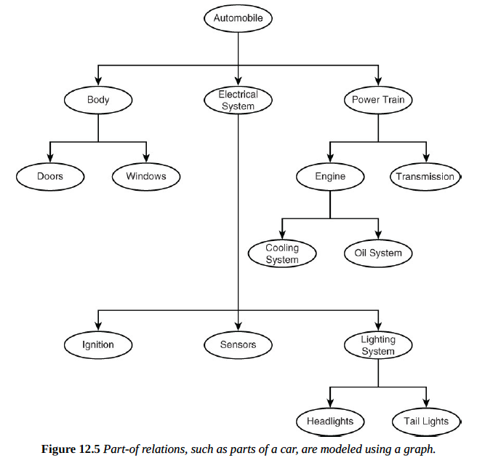
Tree is good to model hierarchical relationship

Slide 14
Modeling social media
Social media like Facebook and LinkedIn allows user to interact and communicate with other online.
A way to demonstrate is introducing new ways of interacting, such as “Like” button.
Social media “Like” can be modeled as a link between a person and a post. Many people can like same post, each post has different number of likes.

Slide 15
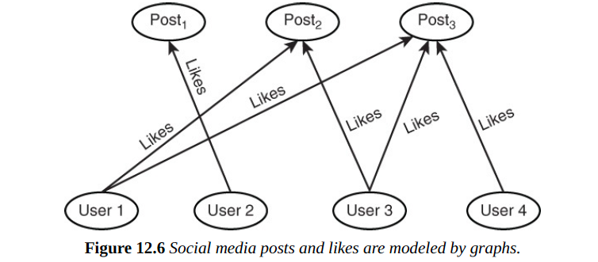
No relationship between posts

Slide 16
Advantages of Graph databases
Query faster by avoiding join
Simplified Modeling
Multiple relations between entities

Slide 17
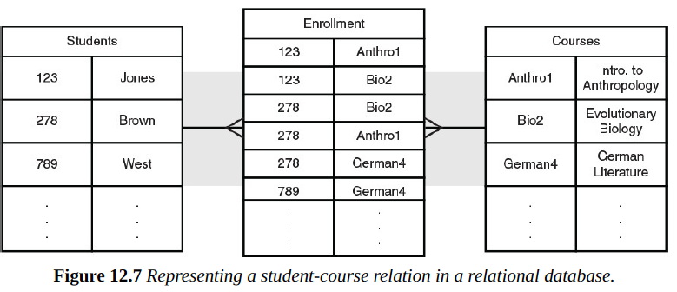
Query faster by avoiding join

Slide 18
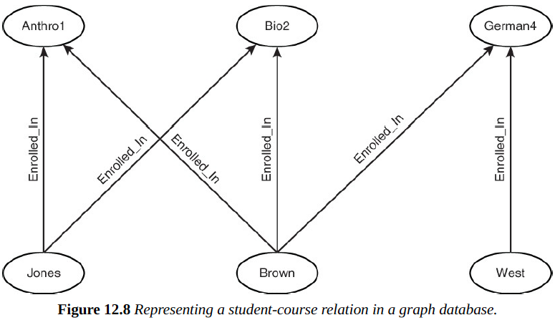
Problem can be modeled using graph databases

Slide 19
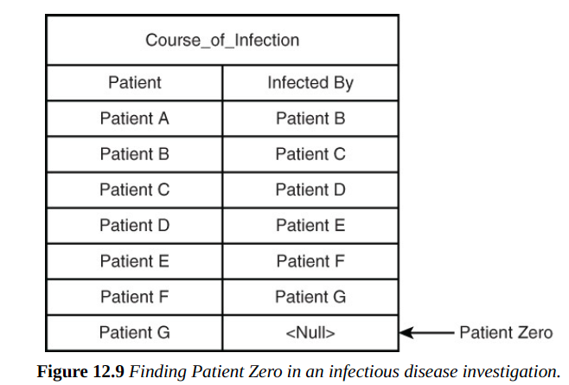
In the figure on the left.
Patient A is infected by B
B is infected by C
…
Q: Who is the source of disease ?
- If start in A, then need to perform join to find she was infected by B. Next, find out C had infected B by joining and so on until find G is the origin.
Process continues until you found the person who was not infected by someone else ➔ patient G
=> In graph database, no need for joining. Follow edges from vertex to vertex.

Slide 20
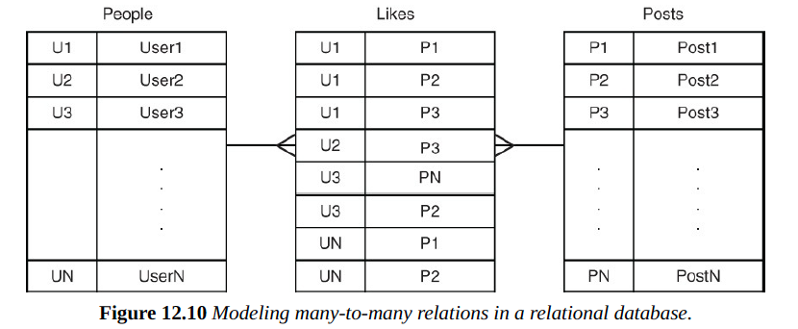
Simplified modeling
No need to create table to model many-to-many relations. Instead, they are explicitly modeled using edges

Slide 21
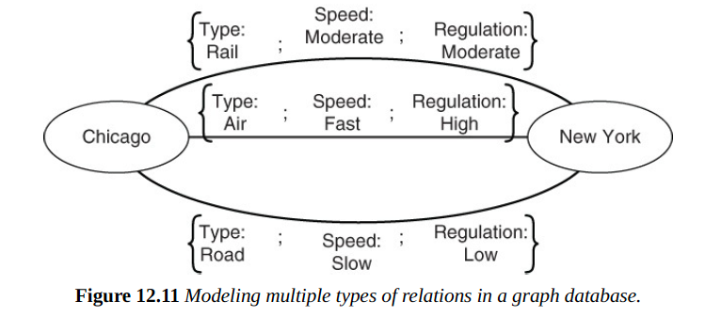
Multiple relations between entities
Using multiple types of edges allows database designers to readily model multiple relations between entities

Slide 22
Graph database terminology

Slide 23
Contents
Elements of graphs
Operations on graphs
Properties of Graphs and nodes
Types of graphs

Slide 24
1. Elements of graphs - Vertex
Represent an entity marked with a unique Id, similar to row key in column-family database or a primary key in RDBMS
Vertex can represent virtually any entity that has a relation with another entity
People in social network
Cities connected by highways
﻿Proteins that interact with other proteins in the body
…
Also have properties. For example: people has name, add, DOB.

Slide 25
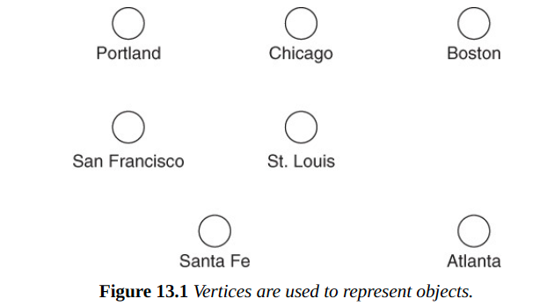

Slide 26
Edge (link or arc)
Define relationships between vertices or objects connecting vertices.
For example: Vertices represent people, edge represents relationships between people: such as ”daughter of” or “father of”
Edge can have properties.
For example: Two people are related by marriage, adoption or biology.

Slide 27
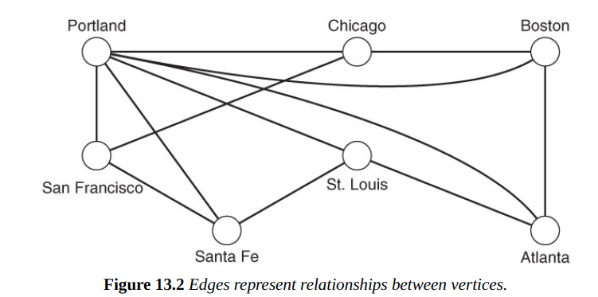

Slide 28
Weight of edges
Weights represent some value about the relationship. For example:
Distance between cities.
Frequency the two individuals post on each other’s walls in social network.
In general, weights can represent cost, distance, or another measure of the relationship between objects represented by vertices.

Slide 29
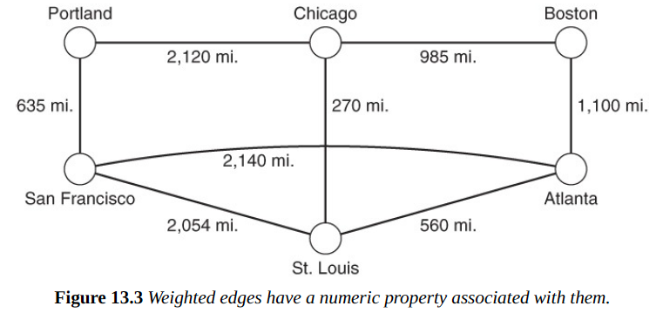

Slide 30
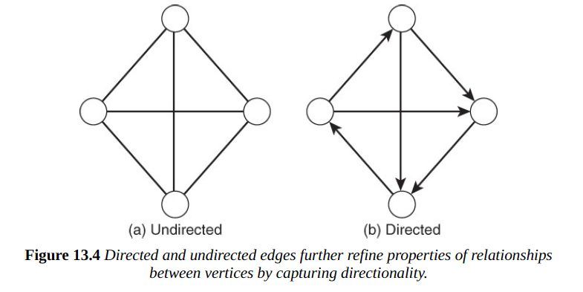
Types of edge
UnDirected | Directed
No direction – assuming 2 ways traffic between vertices | Have a direction - Used to indicate how the relationship should be interpreted

Slide 31
Path
A path through a graph is a set of vertices along with edges between those vertices
If edges are directed, path is directed path.
If the graph is undirected, the paths in it are undirected paths.

Slide 32
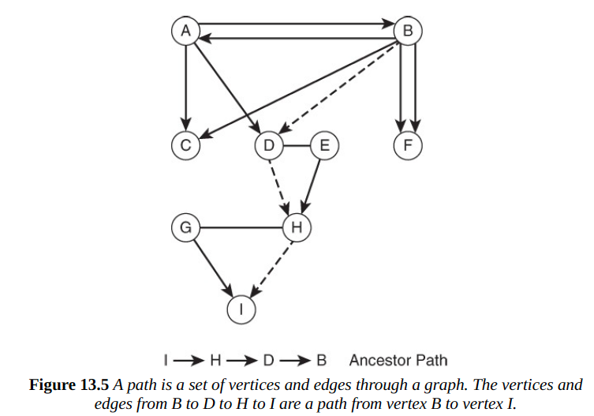

Slide 33
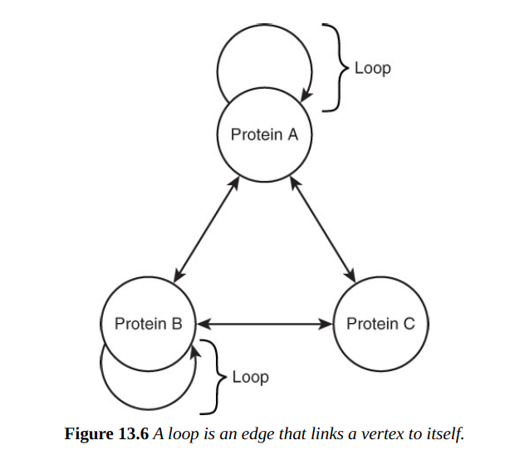
Loop
Loop is an edge that connects a vertex to itself.
However, some graphs do not allow loops

Slide 34
2. Operations on graphs
Common operations such as Create, Update, Retrieve and Delete also can be done in Graph databases as well.
There are some additional operations unique in graph database
Union of graphs.
Intersection of graphs.
Graph traversal.

Slide 35
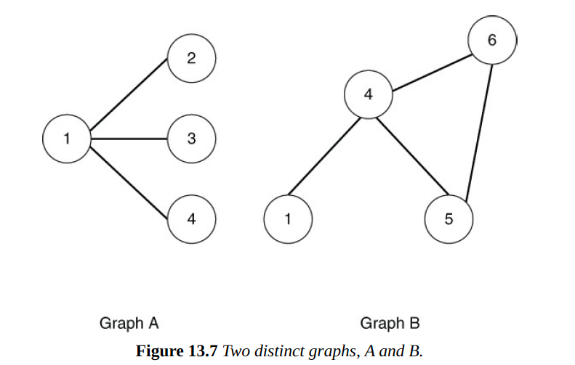
Union of graphs (Lấy hợp của 2 graphs)
Is a combined sets of vertices and edges in a graph.
First graph A has vertices 1, 2, 3 and 4 and edges are {1, 2}, {1,3} and {1,4}. Graph B has vertices 1, 4, 5, 6 and edges {1, 4}, {4, 5}, {4, 6} and {5, 6}

Slide 36
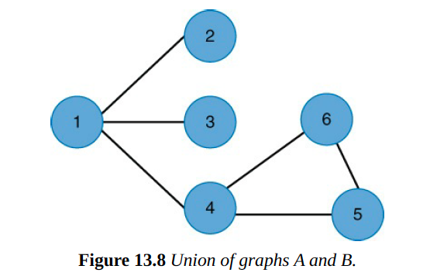
Contd
Union of A and B is the set of vertices and edges from both graphs. Set of vertices is 1, 2, 3, 4, 5, 6. Set of edges is {1, 2}, {1, 3}, {1, 4}, {4, 5}, {4, 6} and {5, 6}

Slide 37
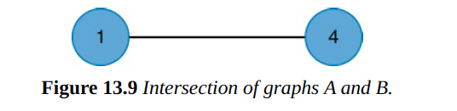
Intersection of Graphs
Intersection of graphs are common edges and vertices between graphs
Only vertices 1 and 4 exist in both 2 graphs. Edge {1, 4} is exist between 2 graphs

Slide 38
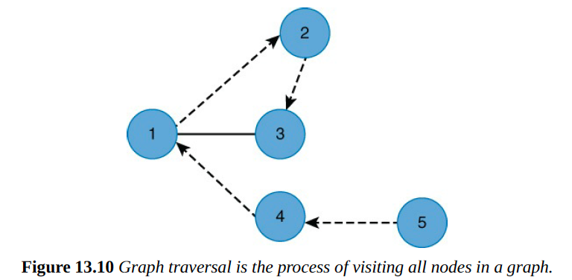
Graph traversal
Is the process of visiting ALL vertices in a graph in a particular way. Purpose is to either set or read some property value in a graph
5->4->1->2->3

Slide 39
3. Properties of graph and nodes
Useful when comparing and analyzing graphs
Isomorphism
Order and size
Degree
Closeness
Betweenness

Slide 40
Isomorphism
Two graph is considered isomorphic if for each vertex in the first graph, there is a corresponding vertex in the other graph
In addition, for each edge between a pair of vertices in the first graph, there is a corresponding edge between the corresponding vertices of the other graph

Slide 41
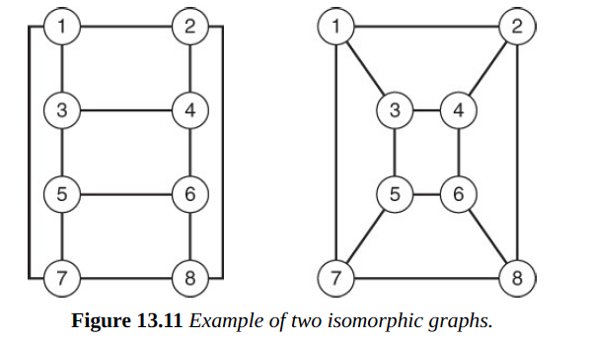
1 match with 2 in 2 graphs, 3 with 4 in 2 graphs… and so on.

Slide 42
Example
In epidemiology – the study of infectious diseases. Epidemiologist build a graph of individuals and their connections to other individuals. They can collect who has the flu at any point and determine how fast it spreads.
If epidemiologists can identify patterns associated with infection, they could then identify other individuals by finding similar patterns and target them for intervention, education, and so on.

Slide 43
Order and size
Order and size measure large of a graph.
Order is the number of vertices and size is the number of edges in a graph
Order and size is important because they can affect time and space required to perform operations such as union, intersection and traverse graph

Slide 44
Degree
Number of edges linked to a vertex and is one way to measure the importance of any given vertex in a graph
Vertices with high degree are more directly connected to other vertices than vertices with low degrees.
Degree is important when addressing problems of spreading information or properties through a network.

Slide 45
Degree = 3

Slide 46
Closeness
Is the property of a vertex that indicates how far the vertex is from all others in the graph
Is an important measure if you want to understand the spread of information in social network, or infectious disease in a community
Vertices with high closeness values can reach other vertices in the network faster than vertices with smaller closeness values

Slide 47
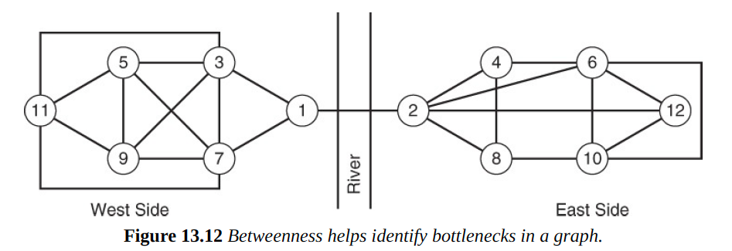
Betweenness
Is a measure of how much of a bottleneck a given vertex is
For example: there is only 1 edge between West and East sides

Slide 48
Contd
Both vertices 1 and 2 will have high betweenness scores as they form a bottleneck in the graph.
If 1 and 2 were removed, it would leave the graph disconnected. However, if you removed nodes 4 and 9, you could still move between any of the remaining nodes.
Betweenness helps identify potentially vulnerable parts of a network. If the bridge were damaged, you will not able to move materials between all vertices in the network.

Slide 49
Types of graphs
Undirected and directed graphs
Flow networks
Bipartite graphs
Multi graphs
Weighted graphs

Slide 50
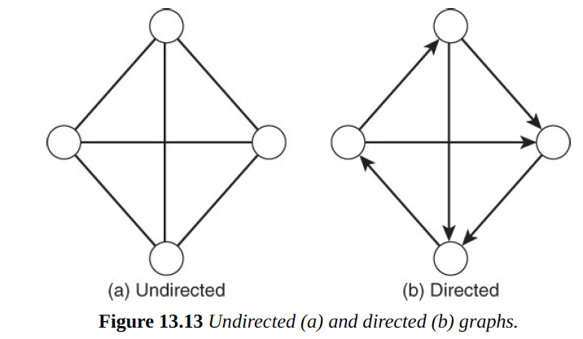
Un-directed and directed graphs
Un-directed: Edges are
not directed. For example
A person works with
another person.
Directed: Edges are
Directed. For example,
person employed by
another person

Slide 51
Flow network
Flow network in directed graph in which each edge has a capacity and each vertex has a set of incoming and outgoing edges.
There are 2 exceptions: source and sink. Sources have no inputs but have outputs, sink have inputs but no outputs.
For example: This is used to model processes with continuous flows, such as network of storm drains that take in rainwater (source) and allow it to flow into river (sink)

Slide 52
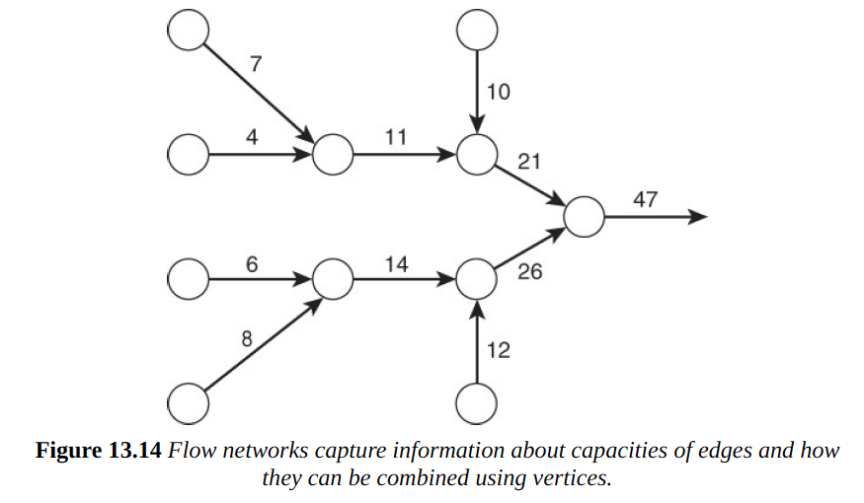
Sum of capacity of incoming edges cannot be greater than the sum of the capacity of outgoing edges

Slide 53
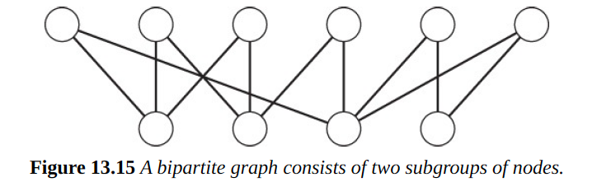
Bipartite graph
This is a graph with 2 distinct sets of vertices where each vertex in one set is only connected to vertices in the other set
Useful when modeling relationships between different types of objects. For example: person works for business, teacher teaches student, members work in groups.

Slide 54
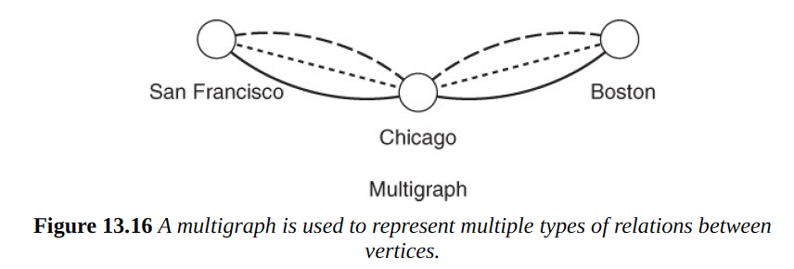
Multigraph
Is a graph with multiple edges between vertices
Multiple edges between cities could represent various shipping options: such as truck, train or plane. The company could use graph database for determining the least costly way to ship items between cities.

Slide 55
Weighted graph
Is a graph in which each edge has a number assigned to it.
The number can reflect a cost, a capacity or some other measure of an edge.
This is used in optimization problems, such as finding the shortest path between vertices – Dijkstra’s algorithm.

Slide 56
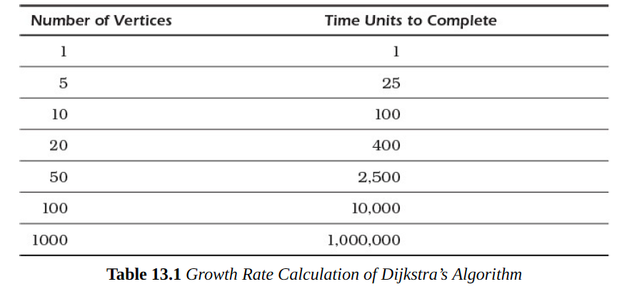

Slide 57
Summary
Graphs are composed of two simple components: vertices and edges.
This simplicity quickly gives way to a broad range of graph properties and features that are useful for modeling a number of phenomena
There are lots of algorithm to work with graph, make graphs a powerful way to represent data in a NoSQL database.

